Slide 1
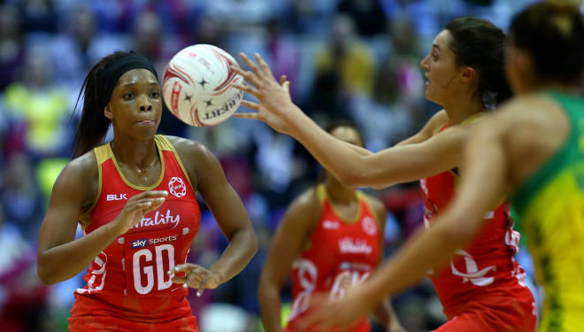
Daily Review
Reminder:
An object at rest remains at rest until acted on by an unbalanced force. An object in constant motion will remain in motion until acted on by an unbalanced force.
Applying Newton’s 1st Law
Describe the motion of the object (at rest or moving) Identify any unbalanced force. Describe the change to the motion of the object.
How does Newton’s 1st Law apply in the following situation?
A netball is caught by a player.
The netball is in motion.
The player is applying an unbalanced force to the ball.
The force applied to the ball will cause it to move.

Slide 2
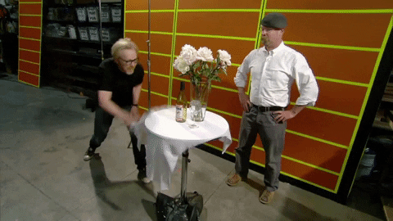
Daily Review
Reminder:
An object at rest remains at rest until acted on by an unbalanced force. An object in constant motion will remain in motion until acted on by an unbalanced force.
Applying Newton’s 1st Law
Describe the motion of the object (at rest or moving) Identify any unbalanced force. Describe the change to the motion of the object.
How does Newton’s 1st Law apply in the following situation?
A table cloth is pulled out from underneath some glassware.
The table cloth and glassware are in a state of rest.
There an unbalanced force applied to the table cloth, but not the glassware.
The table cloth will move from underneath the glassware, while the glassware remain at rest.

Slide 3
Daily Review
CFU 1
What two variables does acceleration depend on?
Newton’s 2nd Law
Newton’s 2nd Law states that the acceleration of an object is dependent of two variables:
The force acting upon the object
The mass of the object
The relationship between force, mass and acceleration can represented by the equation
F_{net} = m x a
Where F_{net} = force in Newtons (N)
m = mass in kilograms (kg)
a = acceleration in metres per second per second (m/s²)
CFU 2
What equation can be used to relate force, mass and acceleration?
CFU 3
If a 10 kg mass is accelerated at 3 m/s², what force, in Newtons, is required?

Slide 4
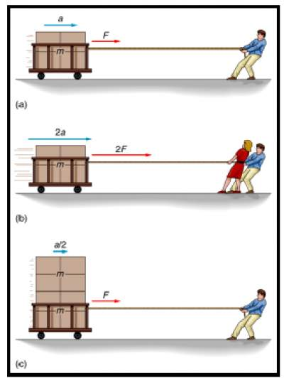
Daily Review
Comparing Acceleration Using Newton’s 2nd Law
Identify whether the mass or force is changing. Describe the acceleration of the objects.
How does Newton’s 2nd Law apply in the following situation?
A person pulls a single trolley along the ground. Two people pull the trolley together.
The force acting on the object is changing.
The trolley will accelerate at a higher rate when pulled with more force.

Slide 5
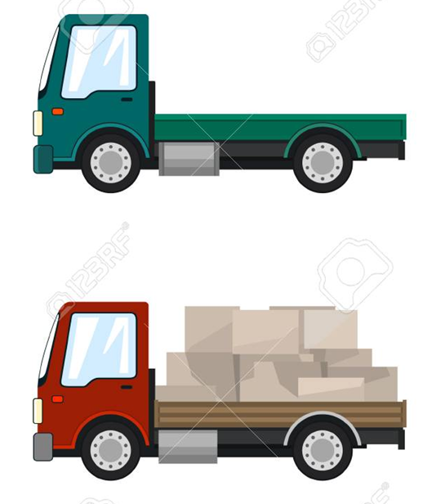
Daily Review
Comparing Acceleration Using Newton’s 2nd Law
Identify whether the mass or force is changing. Describe the acceleration of the objects.
How does Newton’s 2nd Law apply in the following situation?
The mass of a truck is reduced by removing the load. Which truck has a higher deceleration?
The mass of the object is changing.
The empty truck with less mass decelerates at a higher rate than the loaded truck.

Slide 6
Newton’s 3rd Law of Motion Year 10 Physics

Slide 7

Learning Objectives
CFU
What are we going to learn?
Describe Newton’s 3rd Law of Motion.
Apply Newton’s 3rd Law to various situations.
Activate Prior Knowledge
What happens to a balloon when you blow it up and then release it without tying it?
What would happen if you blew the balloon up to a large volume compared to a small volume?

Slide 8
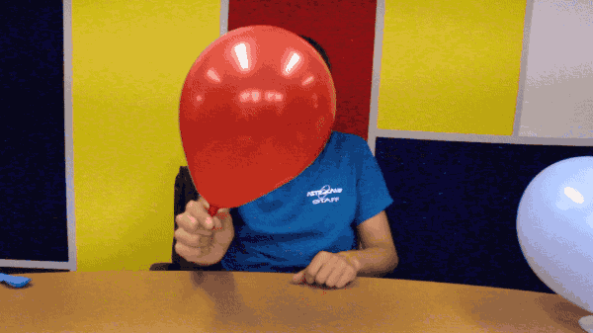
Concept Development
CFU 1
When the air is let out of a balloon, the balloon is pushed forward. In this situation, what is the action force?
Action-Reaction Forces
Isaac Newton realised that forces always occur in pairs.
If a tennis ball is hit by a racquet, the racquet applies a force to the ball and the ball accelerates forward.
This is called an action force.
However, the ball also exerts a force back onto the racquet, which you can feel as you hit the ball.
This is called a reaction force.
CFU 2
When the air is let out of a balloon, the balloon is pushed forward. In this situation, what is the reaction force?

Slide 9
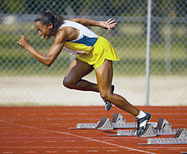
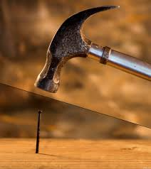
Concept Development
CFU 1
What is Newton’s 3rd Law?
Newton’s 3rd Law
Newton’s 3rd Law states that:
For every action force there is an equal and opposite reaction force.
For example, a sprinter pushes on the starting blocks, which is the action force.
The reaction force is the starting blocks pushing back on the sprinter, propelling them forwards.
The action force is the sprinter’s foot pushing on the blocks
The reaction force is the sprinter moving forward
CFU 2
How does Newton’s 3rd Law apply to a nail being hit with a hammer (hint: which is the action force and which is the reaction force?)

Slide 10
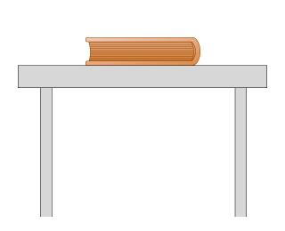
Skill Development/Guided Practice
Allpying Newton’s 3rd Law
Draw a diagram of the situation, including forces. Label and describe the action and reaction forces.
The reaction force is the table pushing up on the book
How does Newton’s 3rd Law apply in the following situation?
A book resting on a table exerts its weight force onto the table. The table exerts and equal force on the book.
The action force is the weight of the book

Slide 11
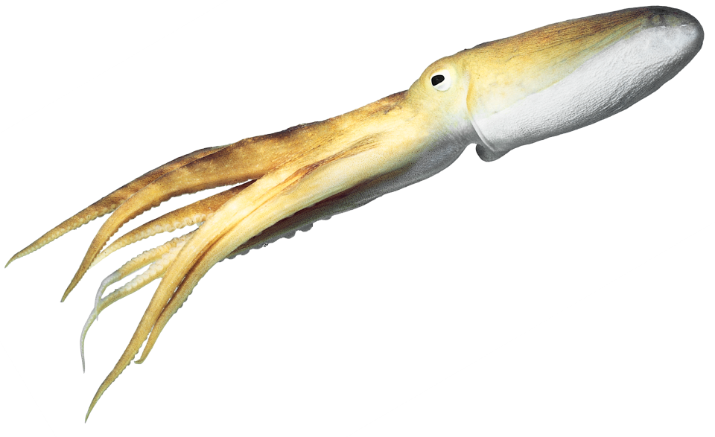
Skill Development/Guided Practice
Allpying Newton’s 3rd Law
Draw a diagram of the situation, including forces. Label and describe the action and reaction forces.
The reaction force is the octopus being propelled forward
How does Newton’s 3rd Law apply in the following situation?
A octopus squirts water out of a tube near its head. The water pushes back on the octopus propelling it in the opposite direction.
The action force is the force of the water moving

Slide 12
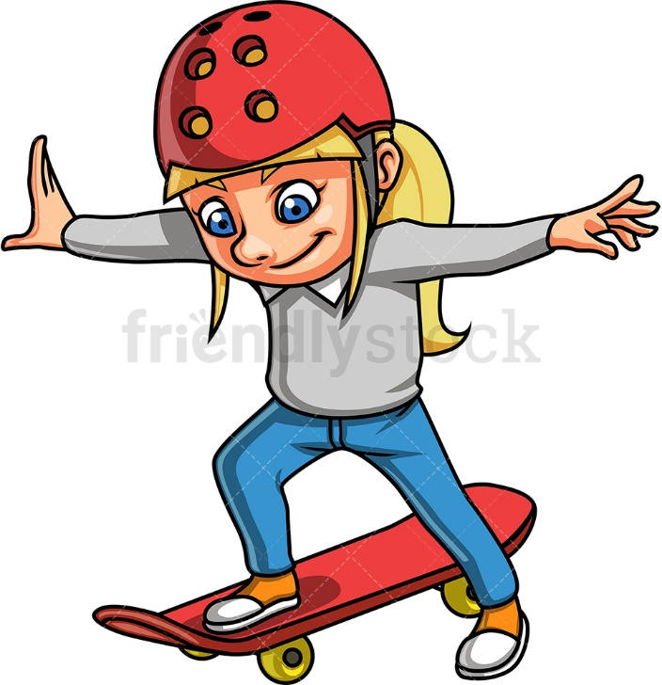
Skill Development/Guided Practice
Allpying Newton’s 3rd Law
Draw a diagram of the situation, including forces. Label and describe the action and reaction forces.
How does Newton’s 3rd Law apply in the following situation?
A skateboarder pushes on the ground, which make them move forwards.
The action force is the girl’s foot pushing on the ground
The reaction force is the girl and the skateboard moving forward

Slide 13
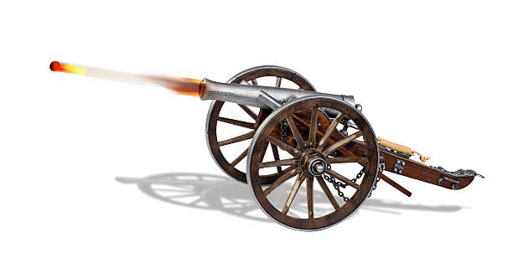
Skill Development/Guided Practice
Allpying Newton’s 3rd Law
Draw a diagram of the situation, including forces. Label and describe the action and reaction forces.
The action force is the cannonball being pushed out of the cannon
The reaction force is the cannon rolling backwards
How does Newton’s 3rd Law apply in the following situation?
A cannonball is shot out of a cannon, causing the cannon to roll backwards.

Slide 14
Relevance
Understanding Newton’s 3rd Law will help you understand why we are able to move by walking and jumping.
It will also help you understand how rockets and jet engines are able to move objects in space, and why objects like cannons and guns recoil when something is shot out of them.

Slide 15
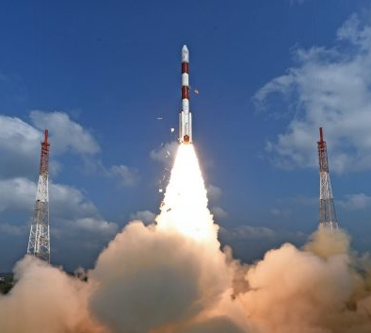
Skill Closure
What is Newton’s 3rd Law of Motion?
Skill Closure
When a rocket launches, gases are pushed out the bottom of the rocket, which propels the rocket upwards. Draw a diagram and label the forces involved in a rocket launching.

Slide 16
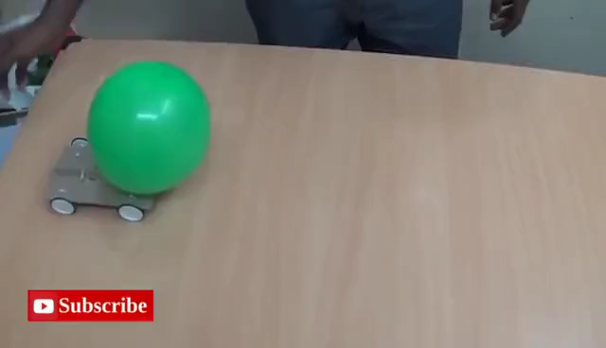
Independent Practice
Complete the worksheet “Newton’s 3rd Law of Motion” on your device.

